Slide 1


Slide 2

Integrate-and-Fire (LIF) Neurons with Sensory Data International Centre for Neuromorphic Systems (ICNS)

Slide 3

Prerequisites:
Basic knowledge of digital circuit design
Understanding one of the Hardware design languages
Basic knowledge of biological neurons (Introduction to Neuroscience 800230)
Understanding LIF neuron circuit design using Verilog
PAGE 3

Slide 4
Contents:
Bio-inspired sensory system
Event-based vision sensor
Event-based cochlea on FPGA (CARFAC and LIF)
Digital system design : event-based cochlea
Clock domain and synchronisation
Time-multiplexing and Pipeline parallel
Interface
Programming a FPGA
PAGE 4

Slide 5
Bio-inspired sensory system
PAGE 5

Slide 6
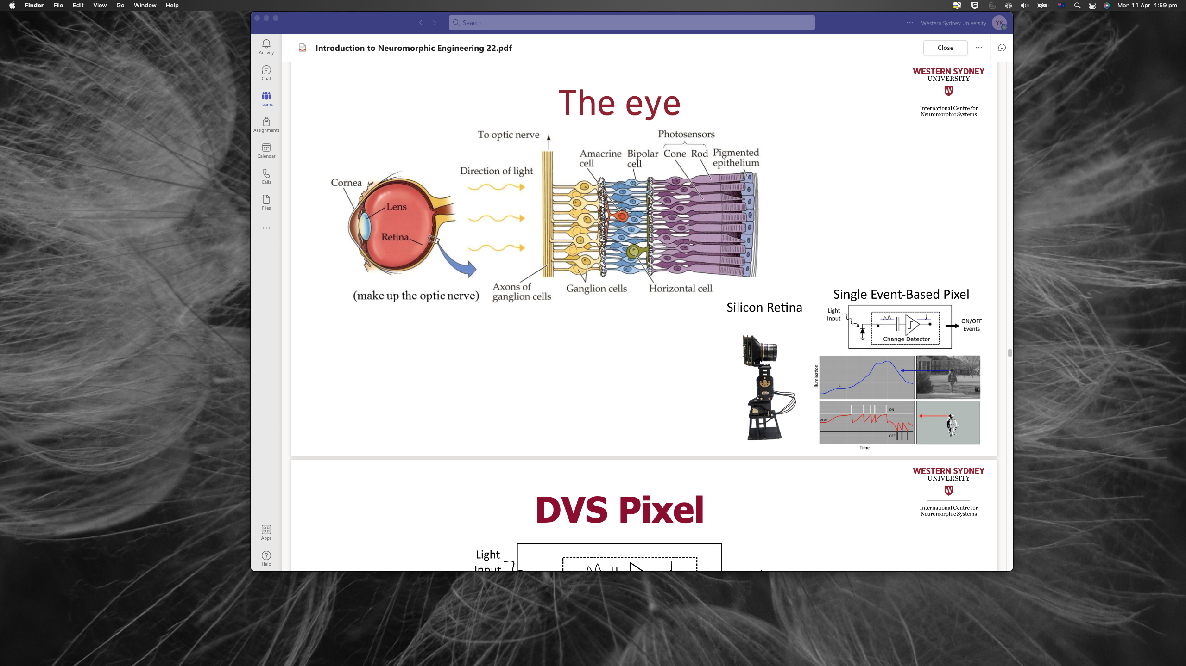
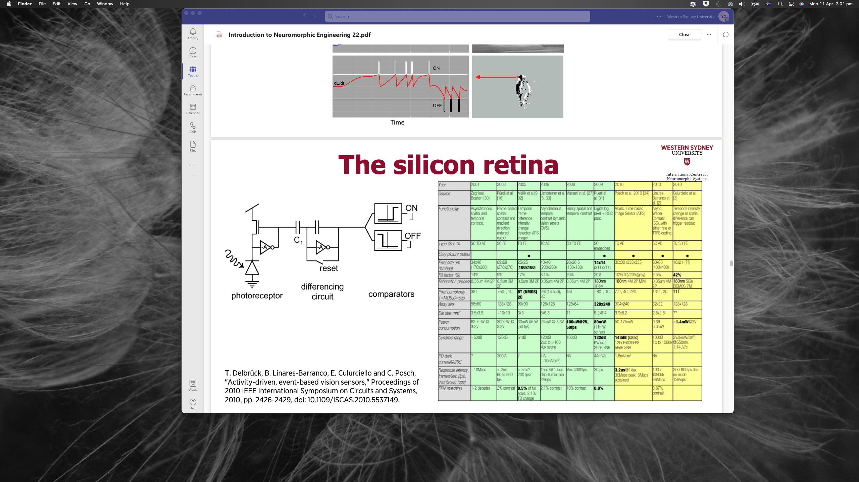
The eye
https://youtu.be/D6rv6q9XyWU
https://youtu.be/6xOmo7Ikwzk
https://www.youtube.com/watch?v=6ciNkcjV6EI
https://www.framos.com/en/news/prophesee-event-based-vision-sensor-the-first-in-an-industry-standard-now-by-framos
https://sensors.ini.uzh.ch/tobi.html
photo-diode
PAGE 6

Slide 7
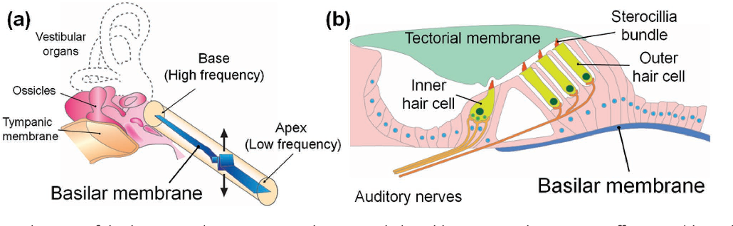
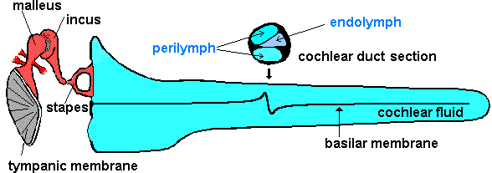
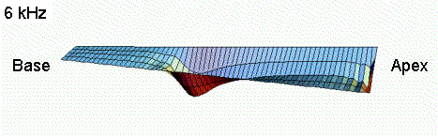
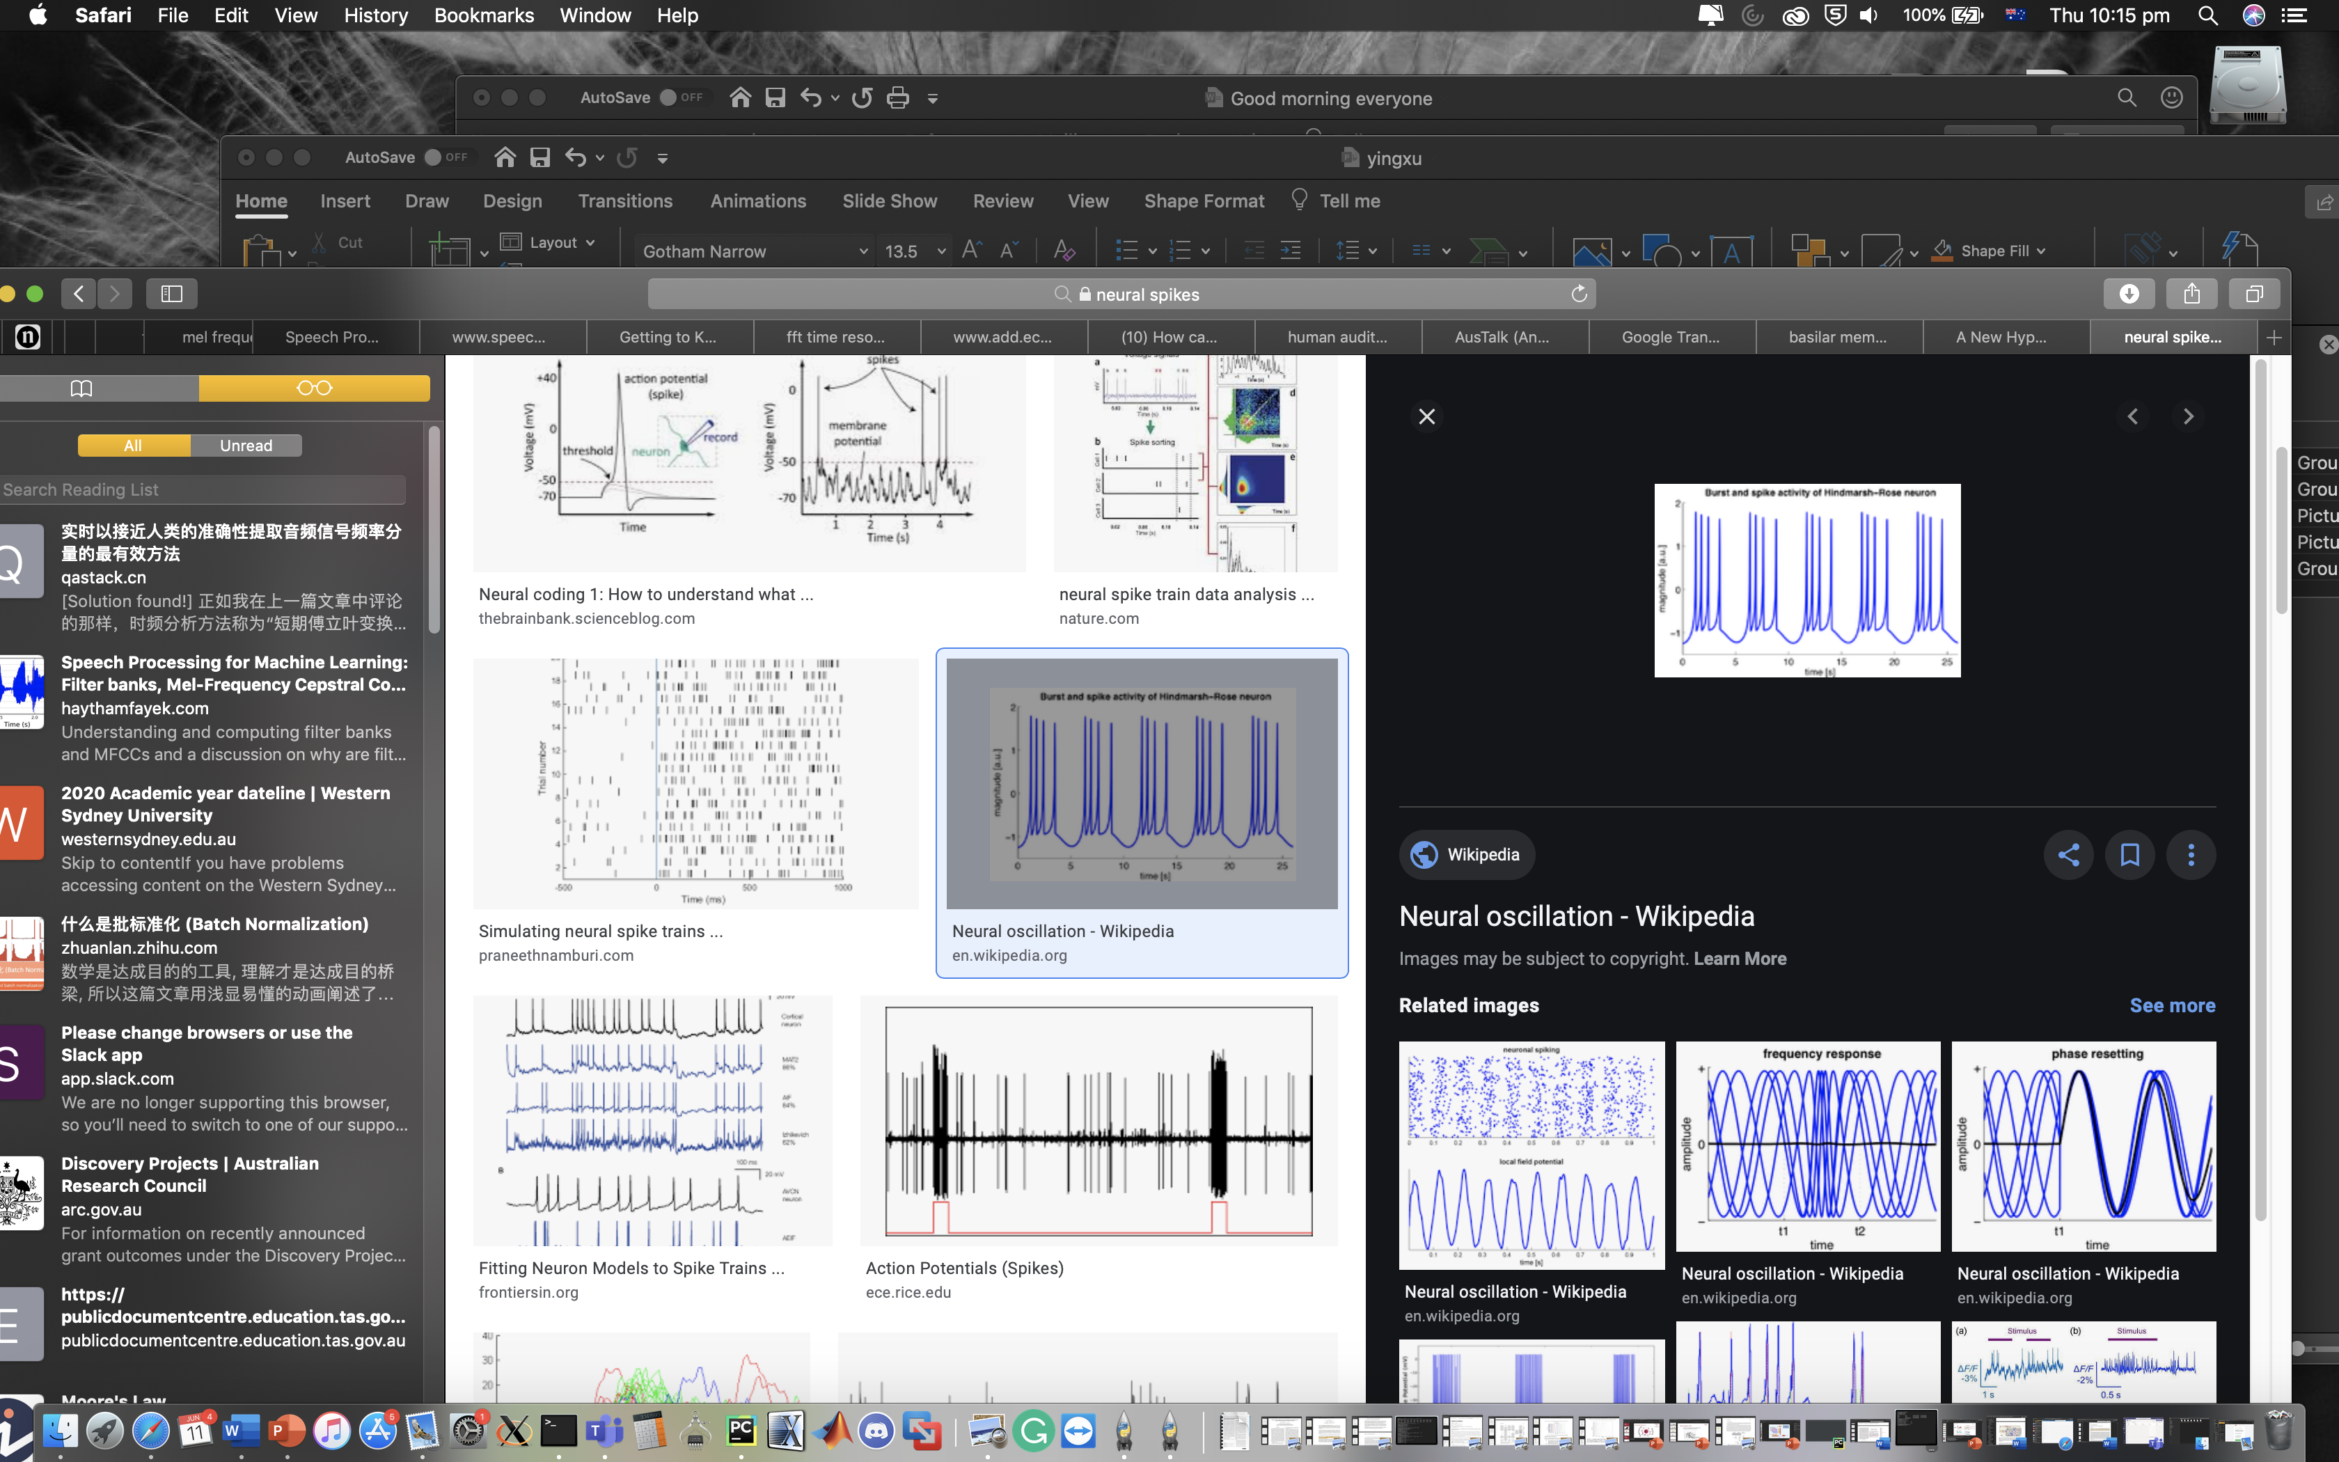
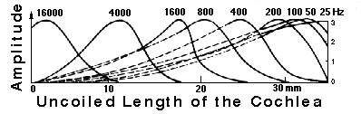
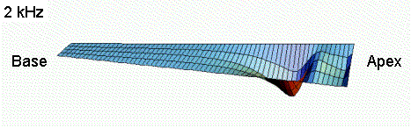
The cochlea
Auditory nerve
Outer ear
Eardrum
Inner ear
(Cochlea)
Middle ear
Uncoiled cochlea
OHCs - actively amplify sound by changing their hair length under stimulation
Sterocillia
bundle
Tectorial membrane
Outer
Hair cell
Position of maximum displacement on the BM varies as a function of frequency content of the input sound
Inner
Hair cell
IHCs - release neurotransmitter and stimulate the auditory nerve
Basilar Membrane
Auditory Nerve
High Frequency
Low Frequency
Basilar membrane
BM: Basilar membrane
IHC: inner hair cell
OHC: outer hair cell
PAGE 7
PAGE 7
Notes:
Melleus incus stapes

Slide 8
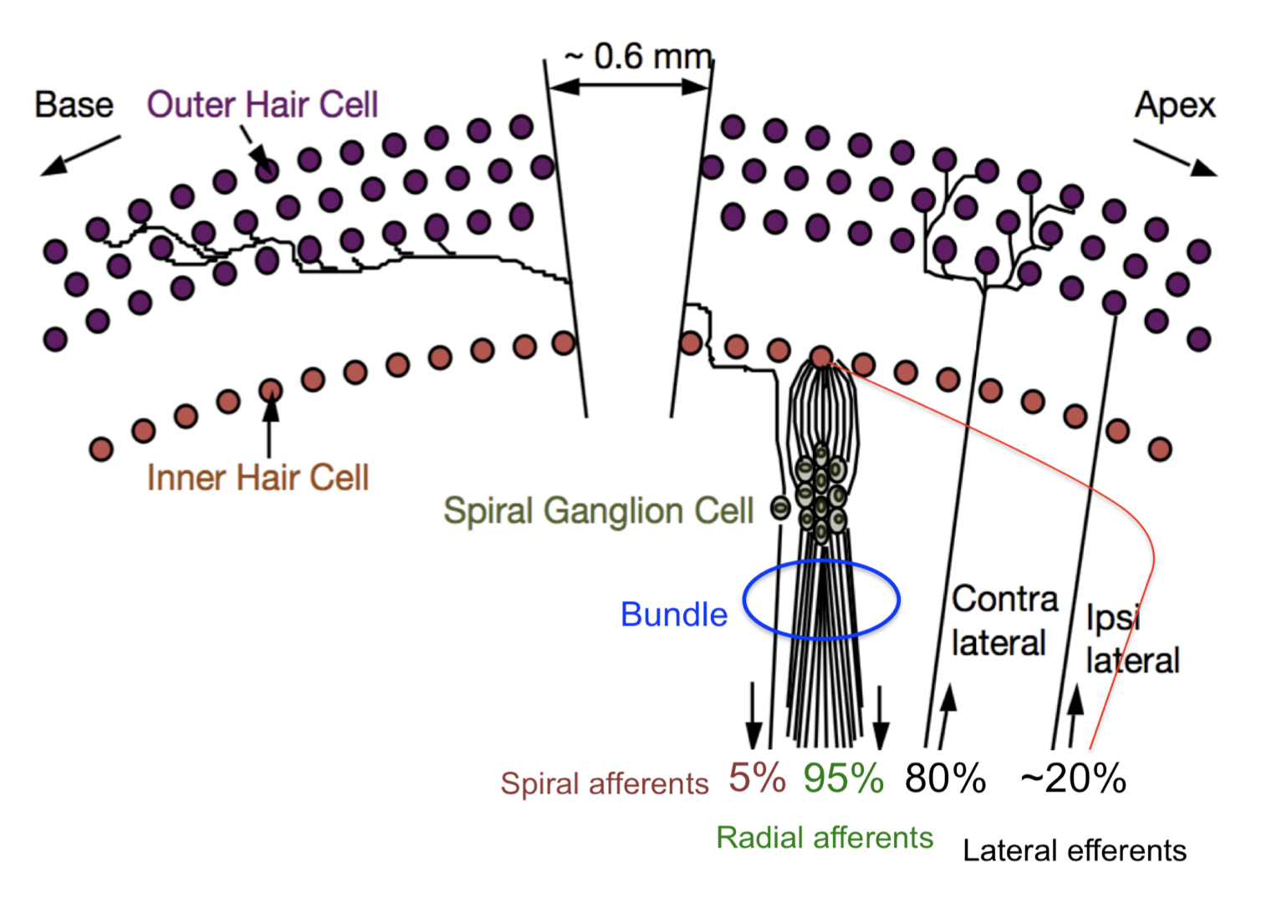
Innervation of hair cells in cochlea
Innervations of the hair cells in humans. Approximately 95% of the afferents come from the inner hair cell, and they are bundled with the spiral afferents that innervate a range of outer hair cells about 0.6 mm basal-ward along the cochlea to form the auditory portion of the eighth cranial nerve. Most efferent fibres (about 80%) contact a range of outer hair cells and come from the contralateral medial superior olivary complex. The remaining 20% of the efferent fibres are from the ipsilateral lateral and medial superior olivary complex.
In rats, each inner hair cell is synaptically connected to approximately 10-20 spiral ganglion neurons forming the radial afferents and approximately ten outer hair cells synapse with one spiral ganglion neuron forming the spiral afferents ascending to the cochlear nuclei

Slide 9
Contents: Question and discussion time

Slide 10
Digital system design
PAGE 10

Slide 11
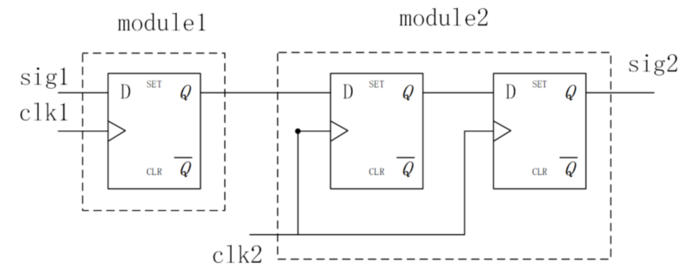
Clock domain and synchronisation
Clock and Clock domain
Clock synthesis in hardware
Synchronisation between different clock domain
Slow to fast
Fast to slow
slow
Delay
fast
Notes:
One clock is enough ?
Why we need clock domains ?
Signal across different clock domain ?
Generate a clock

Slide 12
Clock domain and synchronisation
Input signal clock:
System clock:
Interface clock:

Slide 13
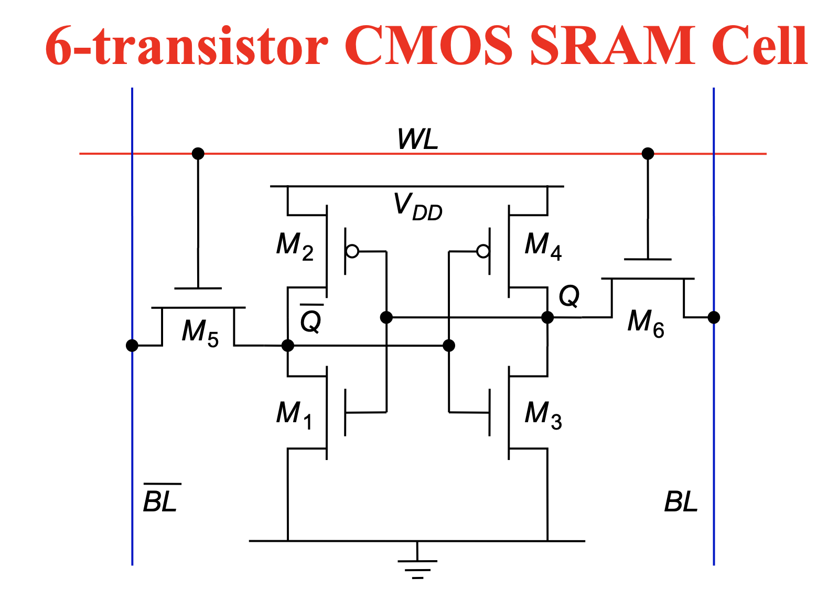
Time-multiplexing and pipeline parallel
Channel1
Channel2
Channel n
BM
DOHC
BM
DOHC
BM
DOHC
DIHC
AGC
DIHC
AGC
……
DIHC
AGC
RAMs
RAMs
RAMs
LIF
LIF
LIF
Memory Initialisation in FPGA: .mif
MIF-memory initialisation file
https://www.intel.com/content/www/us/en/programmable/quartushelp/13.0/mergedProjects/reference/glossary/def_mif.htm
https://faculty-web.msoe.edu/johnsontimoj/EE3921/files3921/ug_ram_rom.pdf
Notes:
random access memory
Read only memory

Slide 14
Time-multiplexing and pipeline parallel
Timing diagram

Slide 15
System design: Interface
jTAG: Joint Test Action Group
USB: Universal Serial Bus
UART: Universal Asynchronous Receiver Transmitter
PAGE 15
Notes:
1.1 12Mbps UART 921.6kbps
2.0 480Mbps
3X 5-20Gbps
4X 40Gbps
qsf

Slide 16
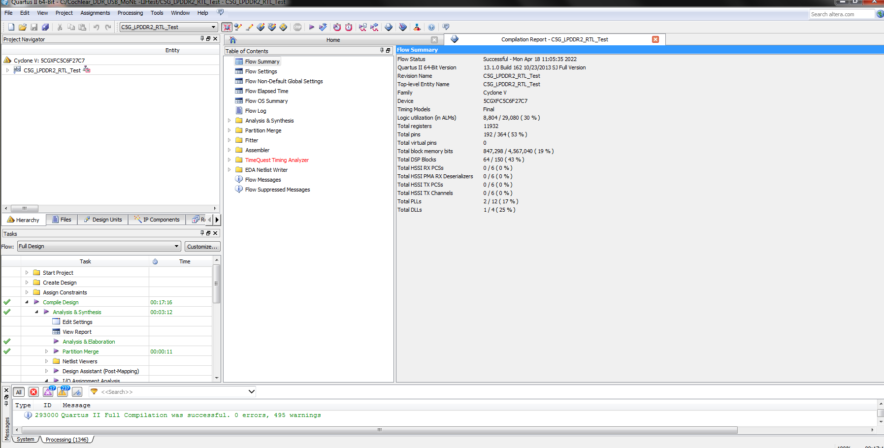
Programming a FPGA
Compile: ALMs/Block RAM/DSP
Programming: jTAG / Active Serial programming : Auto power-on config
User manual
PAGE 16
Notes:
QustaSim
VCS
NC-Verilog
non-volatile

Slide 17
Contents: Question and discussion time

Slide 18
Books and publications : Verilog and FPGA: https://west-sydney-primo.hosted.exlibrisgroup.com/permalink/f/afm582/UWS-ALMA2170487320001571 Analog VLSI: Circuits and Principles: https://ezproxy.uws.edu.au/login?url=https://ieeexplore.ieee.org/book/6267299 Neuromorphic silicon neuron circuits: https://ezproxy.uws.edu.au/login?url=https://www.frontiersin.org/articles/10.3389/fnins.2011.00073/full Neuromorphic engineering systems and applications: https://west-sydney-primo.hosted.exlibrisgroup.com/permalink/f/afm582/UWS-ALMA51173262710001571
PAGE 18

Slide 19
Digital Implementation of High-speed LIF Neurons interfacing with cochlear output
Practice : Discuss and build high-speed LIF neurons interfacing with the cochlear IHCs
PAGE 19

Slide 20
Summary:
Clock domain and synchronisation
Time-multiplexing and Pipeline parallel
Interface
Programming a FPGA
PAGE 20

